Slide 1
JavaScript
Language fundamentals
Arrays, Objects, JSON

Slide 2
Last time
Where did JavaScript come from?
How is it used?
What does it do?
Manipulate the DOM
Respond to events
Today:
JavaScript language fundamental review - variables, conditional code, functions, loops
JavaScript data structures - arrays and objects, JSON

Slide 3
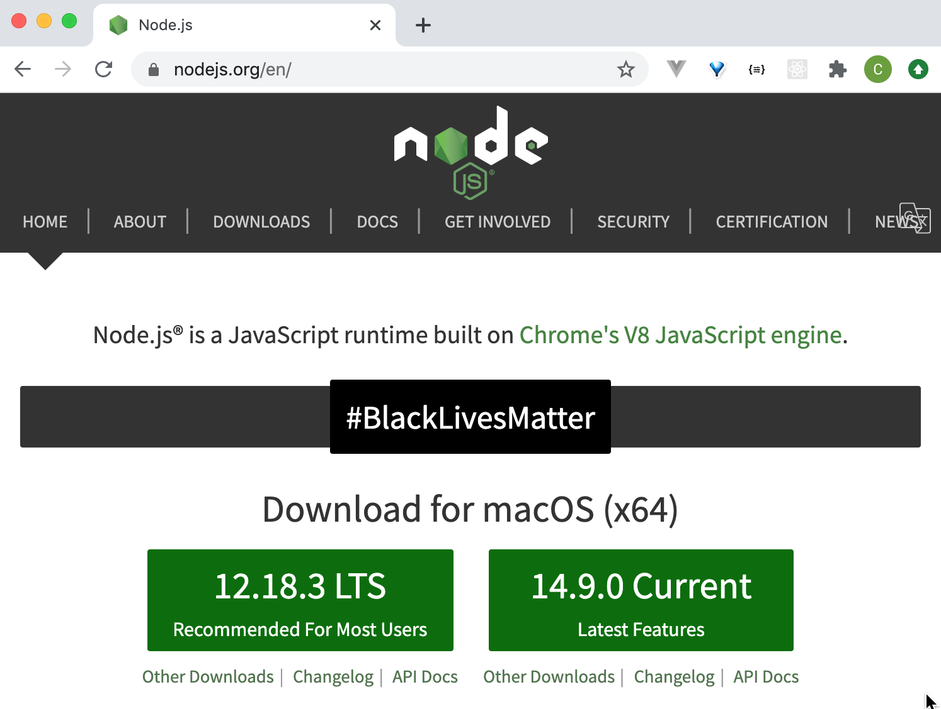
Install Node.js
Install the latest LTS (long term support) version
https://nodejs.org/en/
We'll use it to practice some JavaScript concepts by themselves, without needing to think about HTML too
After installing, restart your editor (VSCode, WebStorm)
Get the latest LTS version for your platform, this number may be higher

Slide 4
Code samples
https://github.com/claraj/week4-examples

Slide 5
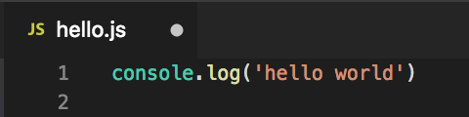
Create a new text file, called hello.js
Add this text
console.log('hello world')
Save your file

Slide 6
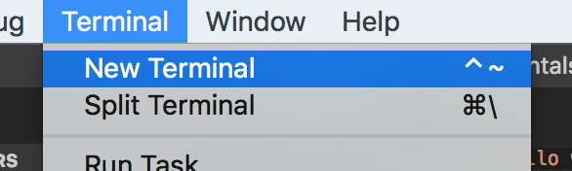
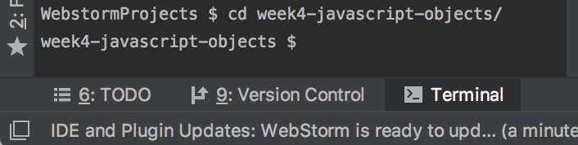
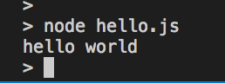
Run hello.js
In your terminal or command prompt, navigate to the directory hello.js is saved in
Your editor may have a a teminal built in, which should open to the correct location
VSCode: Tools > New Terminal
Webstorm: Click Terminal icon, bottom icon bar, left side
Type this to run your code
node hello.js
Error? Verify Node.js installed; Re-start your editor; try again

Slide 7
JavaScript Syntax
Whitespace has no meaning (unlike Python) but typically follows Python/Java/C# -like style for readability
Use { } to indicate blocks of code, for example, functions, loops, conditional statements
You can end lines with a semicolon ; or not, but it’s rarely needed https://news.codecademy.com/your-guide-to-semicolons-in-javascript/

Slide 8
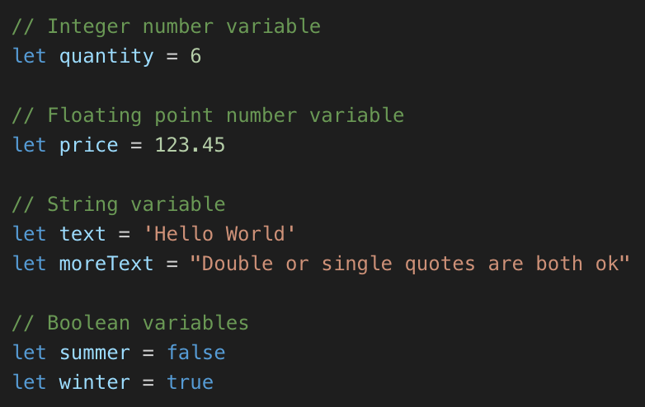
Basic Data Types Use let to create a variable
All numbers, integer and floating point, are stored in number variables
Like Python, JS figures out the type from the data being stored
String variables can use single quotes, or double quotes.
Boolean variables store true or false (Not True and False, like in Python)

Slide 9
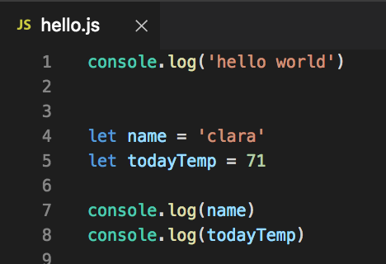
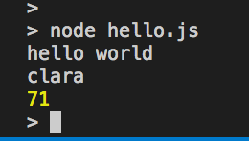
Your Turn - in the same file, or a new file
Create a variable with your name in
Create a variable with today's temperature (for example, 71)
console.log both variables
Run your program again
From the terminal node hello.js
Tip: press the up arrow key in the terminal to recall previous commands

Slide 10
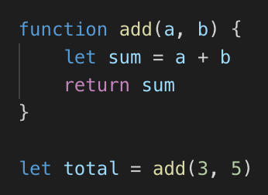
Defining Functions
Example: defining and calling a function using function keyword
a, b are function parameters, used to send data to the function
Use { } to contain function body
return keyword returns data to the caller

Slide 11
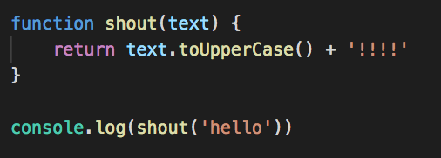
Defining Functions
text is the function parameter, used to send data to the function
return keyword returns data to the caller
Prints HELLO!!!!

Slide 12
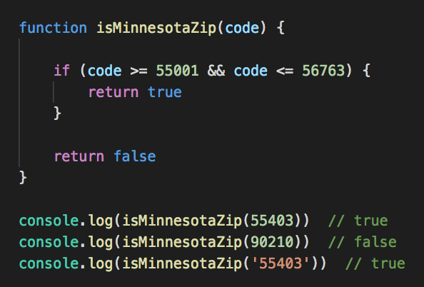
Defining Functions
All of Minnesota's zip codes are between 55001 and 56763
A function to check if a zip code is valid for Minnesota
&& is the AND operator
Note type coercion in the condition when function is called with a string
https://www.zip-codes.com/state/mn.asp#zipcodes

Slide 13
Functions - your turn
Write a function that takes a GPA value as a parameter
Return true if the GPA is between 0 and 4
Return false otherwise
Call your function to check it works
If you call your function with -3 or 4.1 it should return false
If you call your function with 2.5 or 4 it should return true

Slide 14
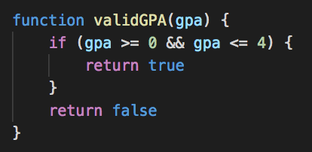
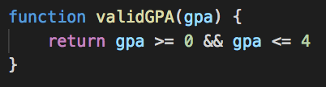
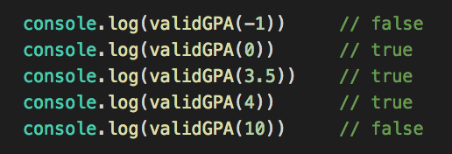
GPA checking function
Example solution
More concise variation

Slide 15
Functions - your turn
Write a function that has two parameters, a city and a state
For example, 'Minneapolis' and 'MN'
It should join the name of a city and state into one string, joined with a comma, in the form used in an address
For example, 'Minneapolis, MN'
Can you make sure the state is capitalized?
Example: convert 'mn' to 'MN'
The function that converts a string to uppercase is called toUpperCase()

Slide 16
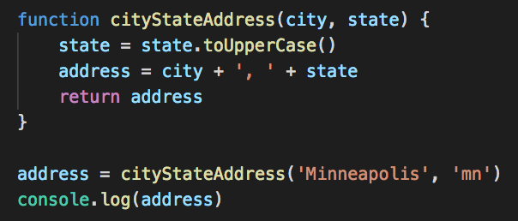
City and state example solution
Prints 'Minneapolis, MN'

Slide 17
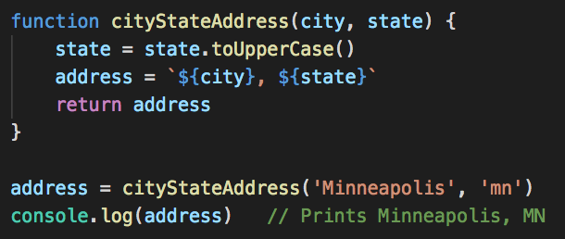
City and state example solution 2 - Template String
Use `
backticks
Anything in ${} will be evaluated and inserted into the string

Slide 18
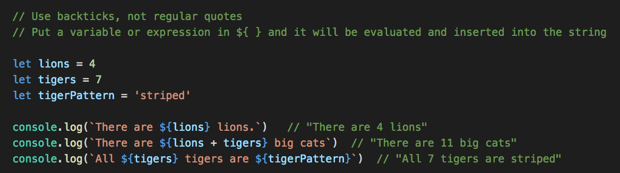
Template Strings
Can put variables or expressions in the ${}

Slide 19
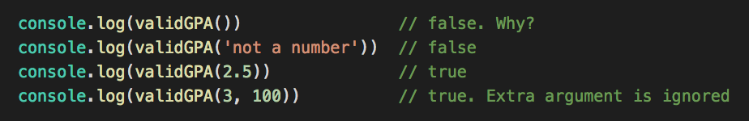
What happens if you call validGPA with a different number of arguments?
JavaScript does not require all the arguments defined
It does not do any type checking
It will ignore any extra arguments - but you can access them if needed
If you don't provide an argument, it will have the value undefined in the function

Slide 20
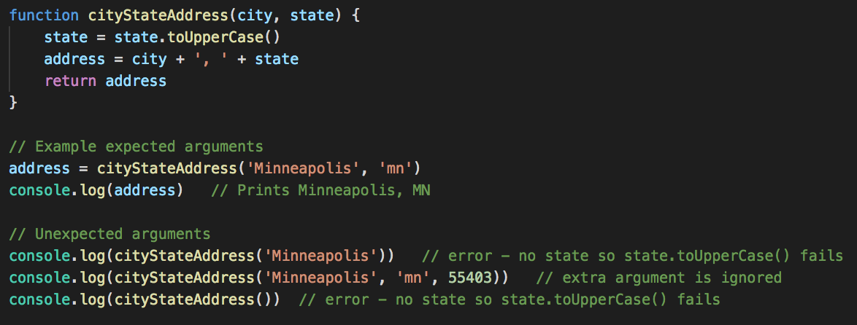
What happens if you call cityStateAddress with a different number of arguments?
Calling a function on an undefined value is an error

Slide 21
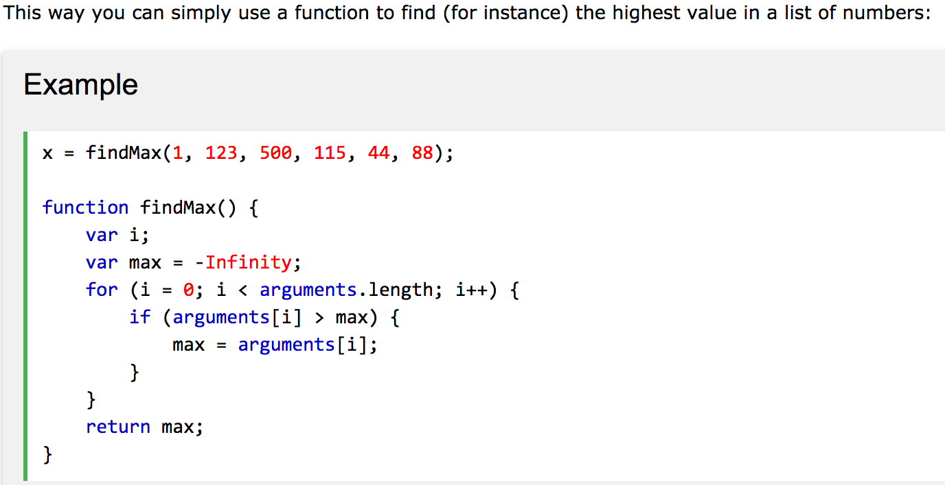
Extra arguments to a function are available in a variable called arguments, this can be useful
http://www.w3schools.com/js/js_function_parameters.asp

Slide 22
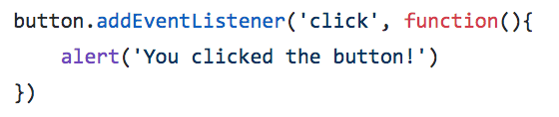
Function definitions as arguments to other functions
Very common in JavaScript
JavaScript can only do one thing at a time - no threading
Problem: for code that takes a long time to complete (e.g. fetch data from a server) the entire program must stop and wait until done
Problem: how to write code that will run in the future - for example, when a button is clicked?
So code that needs to be asynchronous - run at a different time - is invoked by calling a function, and that function typically takes a function definition - a callback function - as an argument.
For slow tasks - the callback function will be called when the slow task completes,
For event handlers - the callback function will be called when the event happens
This might sound weird and confusing – but we’ll see lots of examples

Slide 23
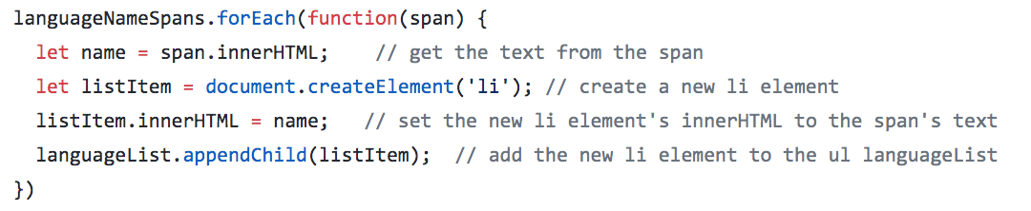
Function definitions as arguments to other functions Functional programming
Also used to implement functional-style code - example, forEach function
Call functions on things to do tasks
Most of the code you've written so far is imperative style - a list of instructions, mutate state in the program
https://en.wikipedia.org/wiki/Functional_programming
A good intro https://codeburst.io/a-beginner-friendly-intro-to-functional-programming-4f69aa109569

Slide 24
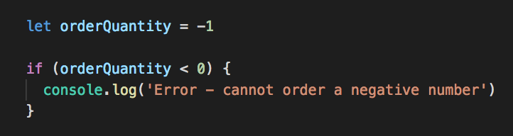
If Statements
Similar operators as Java, C#, Python === < <= > >= !== The ( ) around the condition are required Use { } to contain the conditional statement(s)

Slide 25
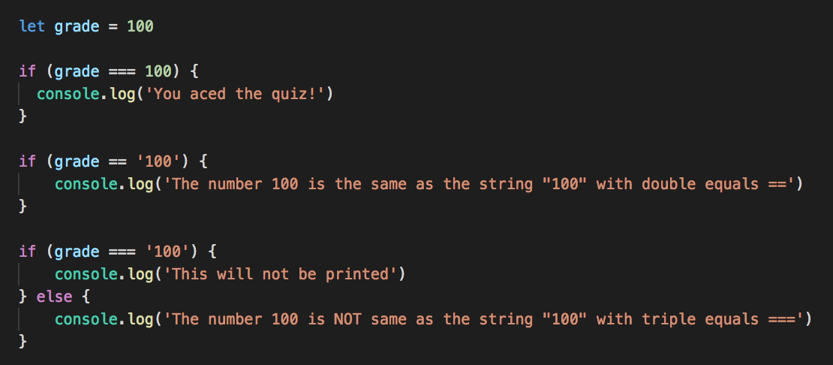
If statements - testing for equality
== will attempt to convert types before comparison, so '10' == 10 is true
Three equal signs === will check the type of the variable being compared, they must be the same for the comparison to be true

Slide 26
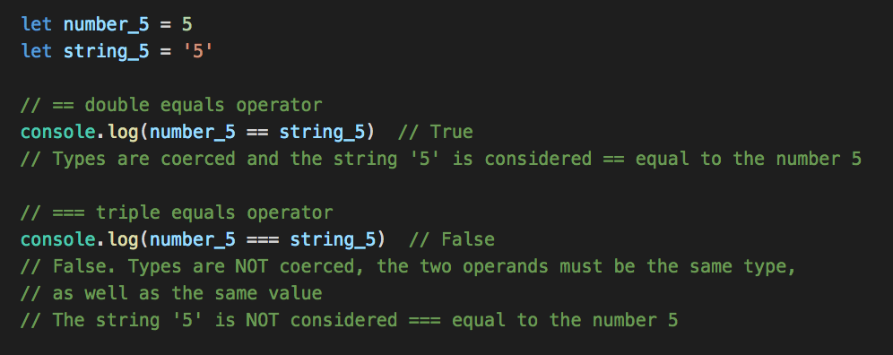
Is "5" equal to 5 ?
Using the == operator, if variables can be coerced to the same value, they are considered equal
To make JS check type as well as value, use the === operator
There's a !== operator for checking non-equality

Slide 27
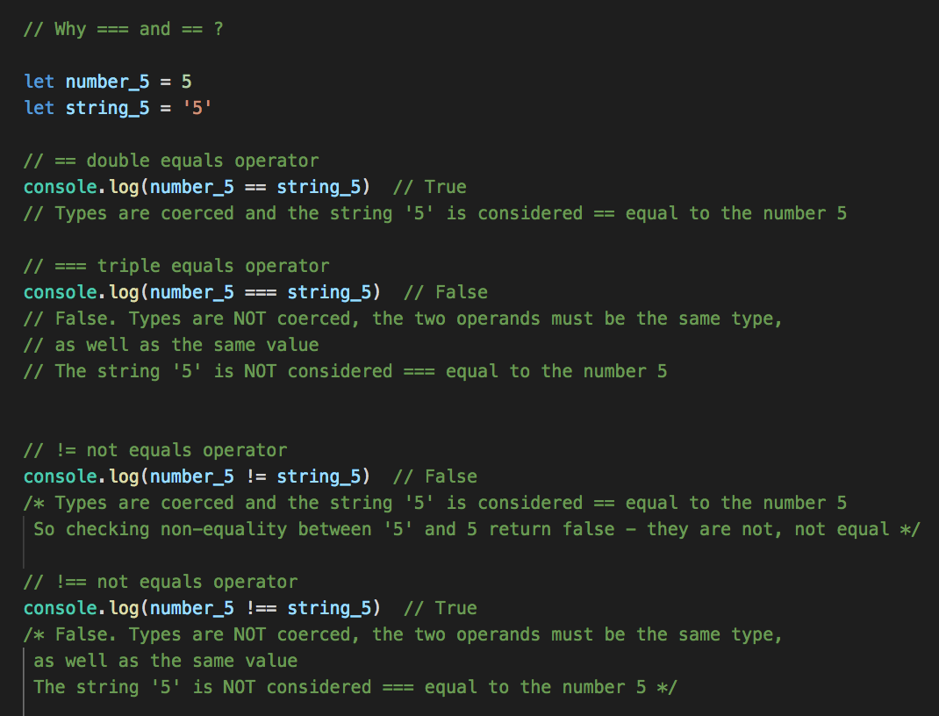
!= and !==
Use !== unless you know you want types to be coerced
Example: all values in HTML inputs are strings, even for values like 100
So you'd use == to check

Slide 28
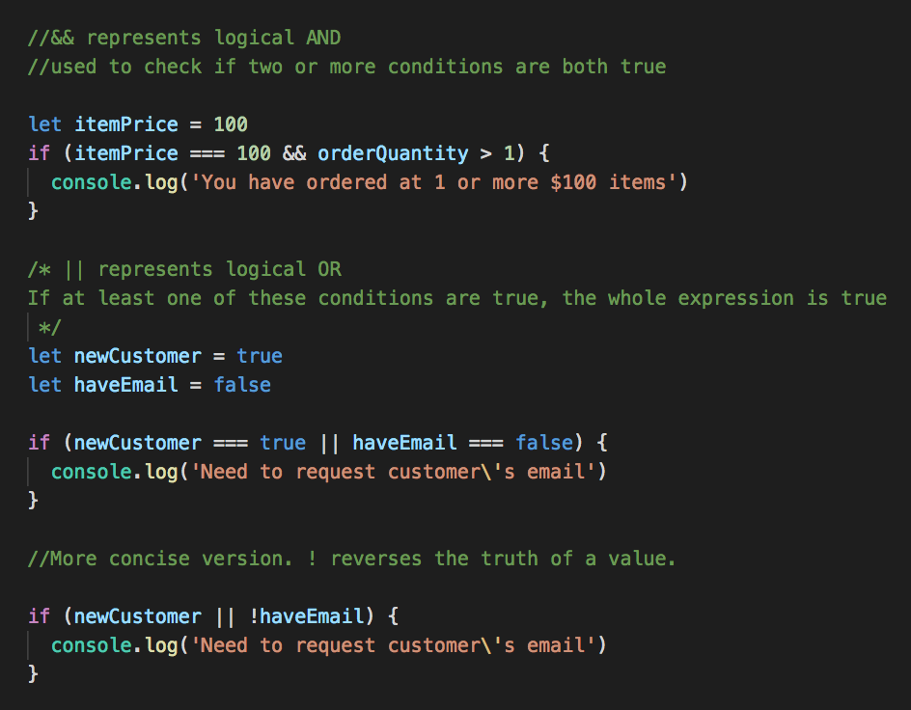
AND and OR || for OR && for AND

Slide 29
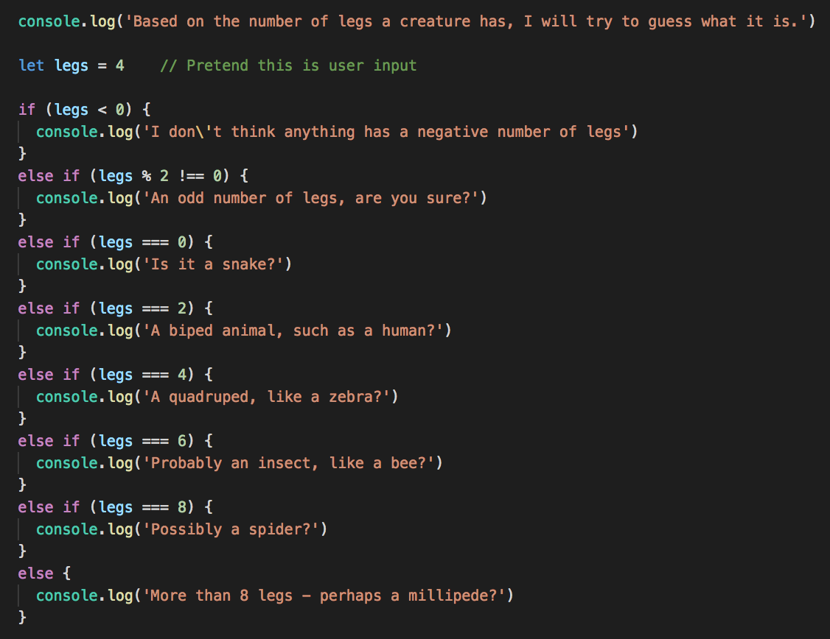
If / else if / else
Use as many else if clauses as needed

Slide 30
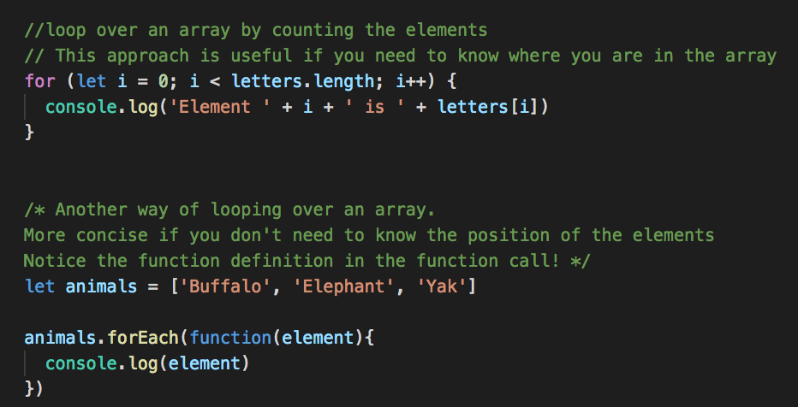
Loops in JavaScript
Looping over a NodeList or array – two ways
First way should look familiar if you’ve taken C# or Java

Slide 31
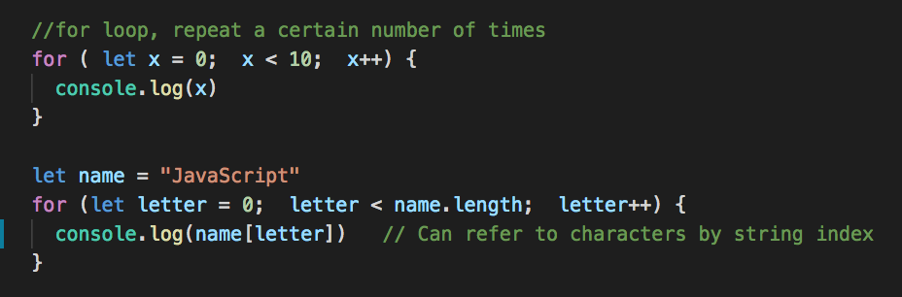
For loops examples

Slide 32
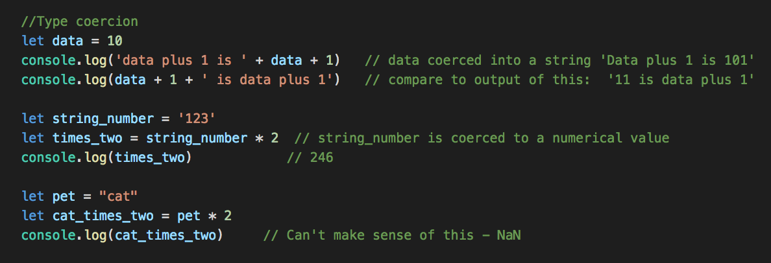
Type coercion
JavaScript isn't strict with types; if it is asked to work with a type it doesn't expect, it tries to convert (coerce) it to the correct type; usually it carries on even if the result doesn't make sense, which can lead to weird errors
JS will try and convert types if possible, to make sense in the context of an operation
NaN, not a number, is a JavaScript value, is the result of trying to do math on non-math variables/values

Slide 33
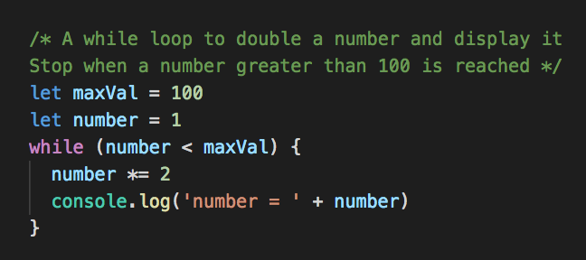
While loops
Same concept as Python, note the () around the condition and {} for the loop body

Slide 34
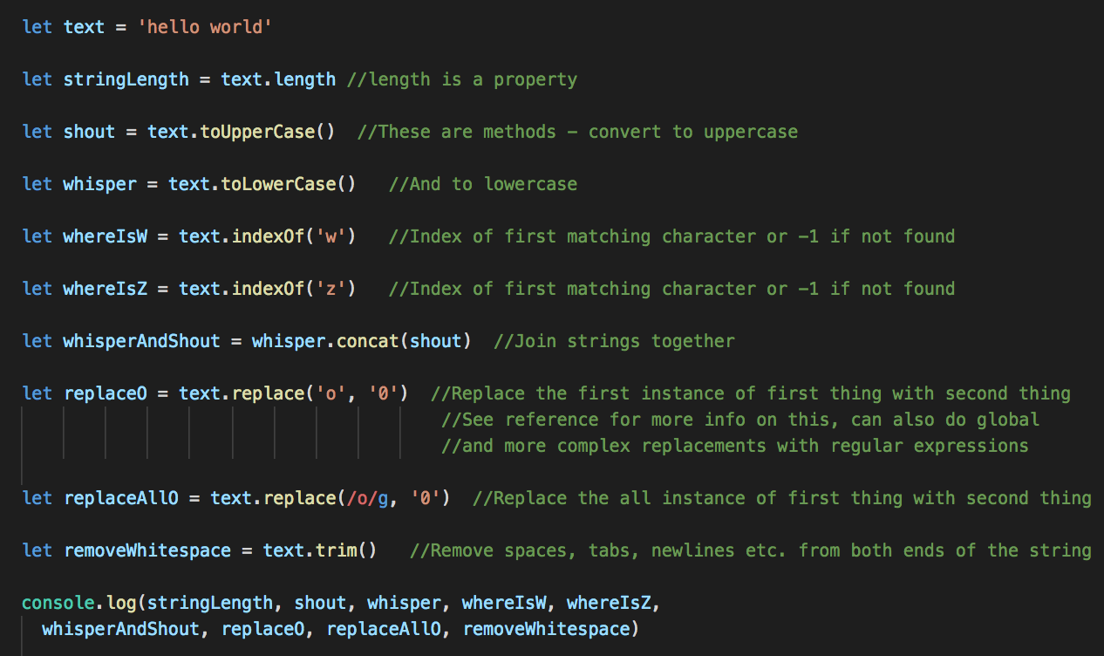
Strings: Various library functions
https://developer.mozilla.org/en-US/docs/Web/JavaScript/Reference/Global_Objects/String

Slide 35
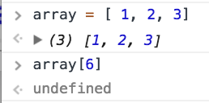
Special values; Undefined, null, NaN, Infinity
undefined: a variable that has not been defined. Example: reading a value from a non-existent array element
null: a value that indicates 'there is no data here'
e.g. if plotting a graph of daily temperatures and you don't have data for one day, you can set the temperature to null
querySelector returns null if no matches
Used in places where None (Python) and null (C#, Java) are used in other languages

Slide 36
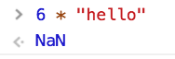
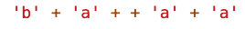
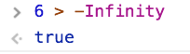
Special values; Undefined, null, NaN, Infinity
NaN: not a number. Often the result of doing math with Strings or non-numerical data
Weird JS – this is valid JS, what does it evaluate to? Why?
Infinity and –Infinity to represent highest and lowest possible numerical values

Slide 37
Weird JavaScript
Take care when programming in JavaScript
There's many cases of subtle, weird behavior
It will let you make mistakes that Java/C#/Python won't, which often cause hard-to-find bugs
Testing your code is very important - is it behaving the way you want?
Review your logic, use the debugger in dev tools, console.log statements
https://github.com/denysdovhan/wtfjs

Slide 38
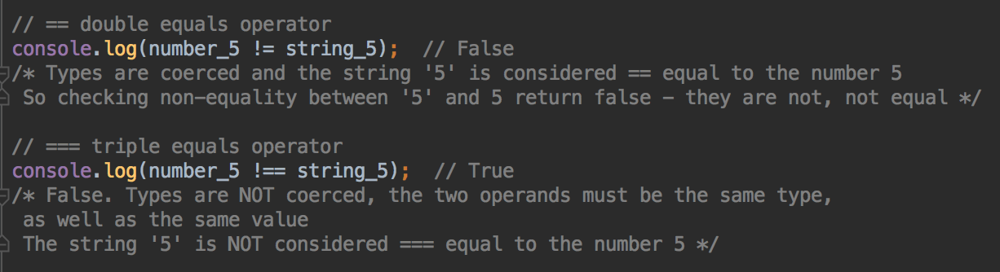
Comments
Single line comments start with //
Multi-line comments start with /* and end with */
Single line comment
Multi-line comment

Slide 39
Comment your code!
Labs and projects expect you to comment your code
Comment should focus on the more complex parts of your code
Explain your code to yourself
Exercise: read a piece of code you wrote last semester. Do you know what it does? Did you comment it? Did that help you understand?
I read code I wrote 6 weeks ago and have no idea what it does if I don't write comments!

Slide 40
JavaScript Arrays and Objects

Slide 41
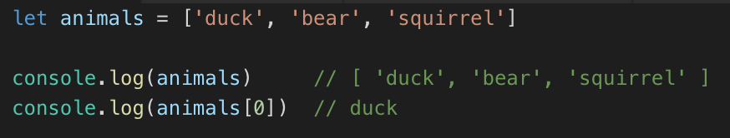
JavaScript Arrays
Use [] to define an array
Length is not fixed, can add and delete elements
Use array[index] to access and modify elements

Slide 42
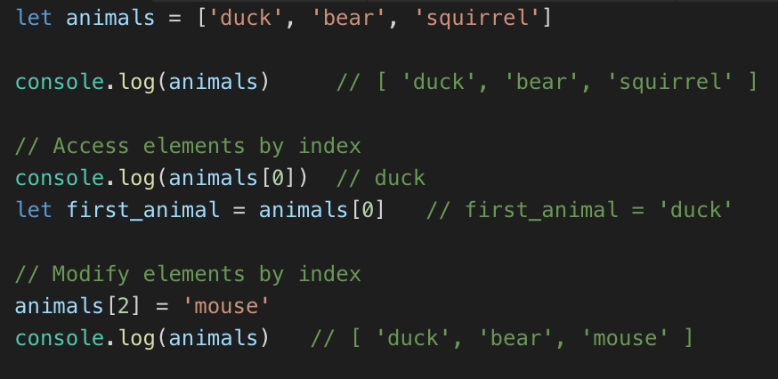
Modifying Elements
Modify by index

Slide 43
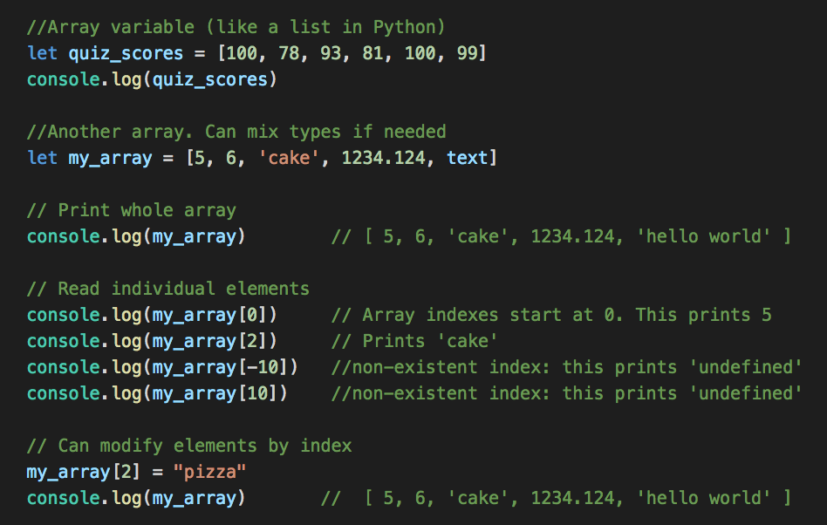
Creating your own Arrays
More like lists in Python, can change size of array
Define with square brackets [ ]
Can store the same type, or mix of types
Read and write individual elements with [] notation

Slide 44
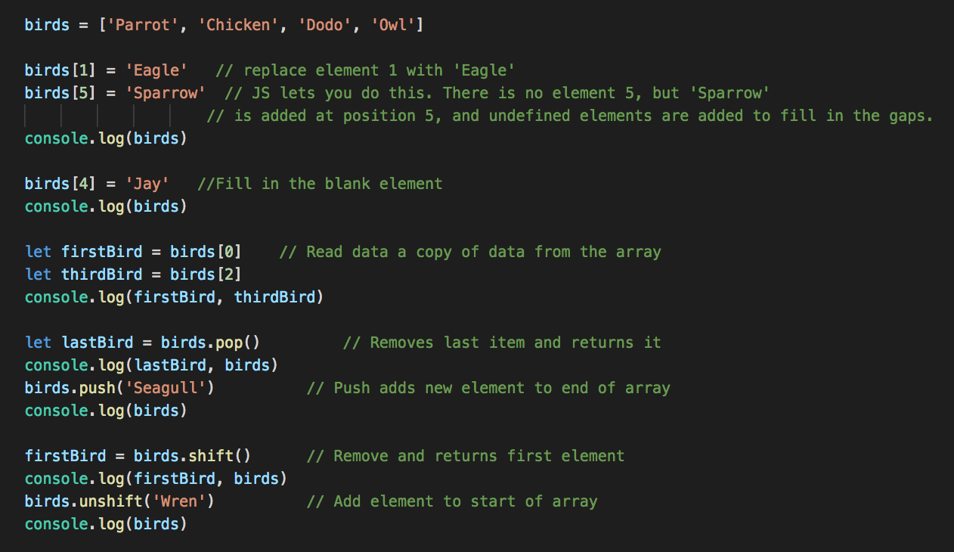
Array Manipulation

Slide 45
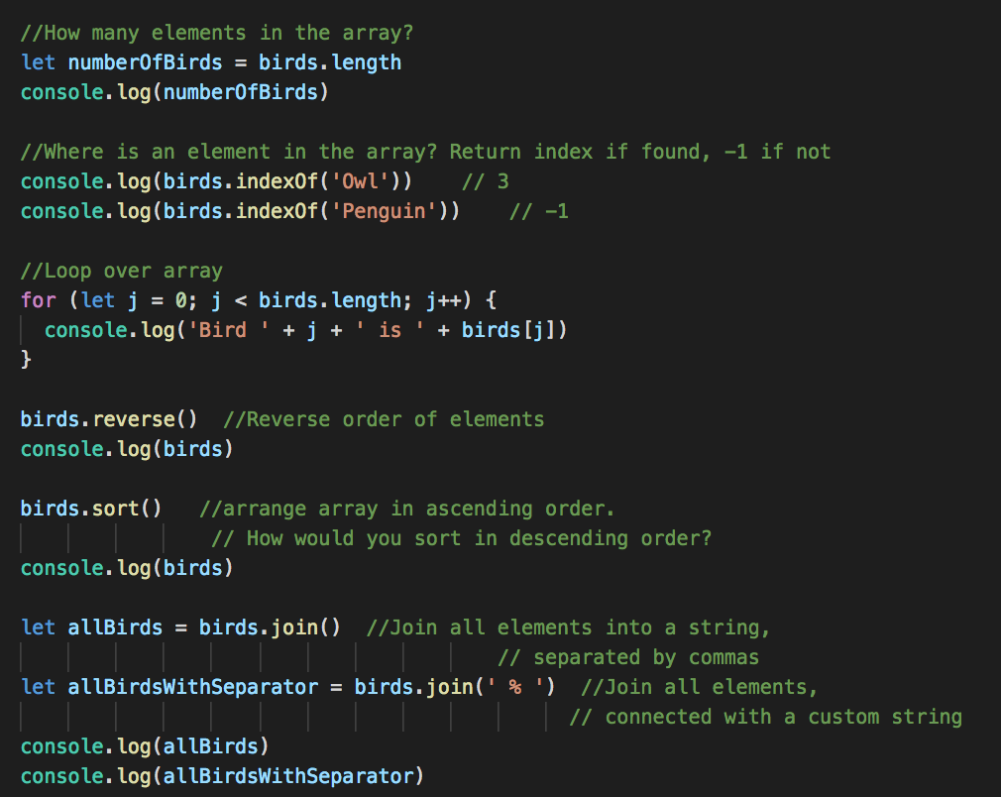
Array Manipulation

Slide 46
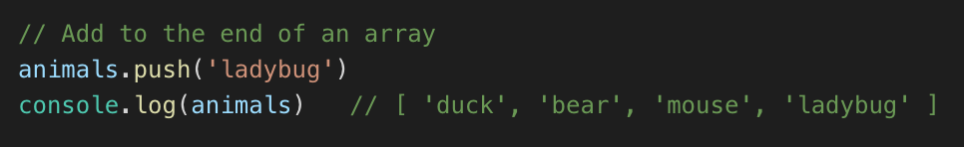
Adding elements
push adds an element to the end of an array

Slide 47
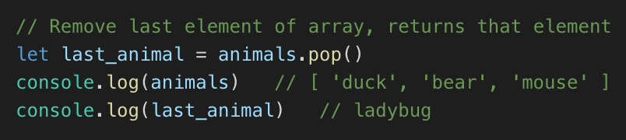
Removing elements
pop removes and returns the last element

Slide 48
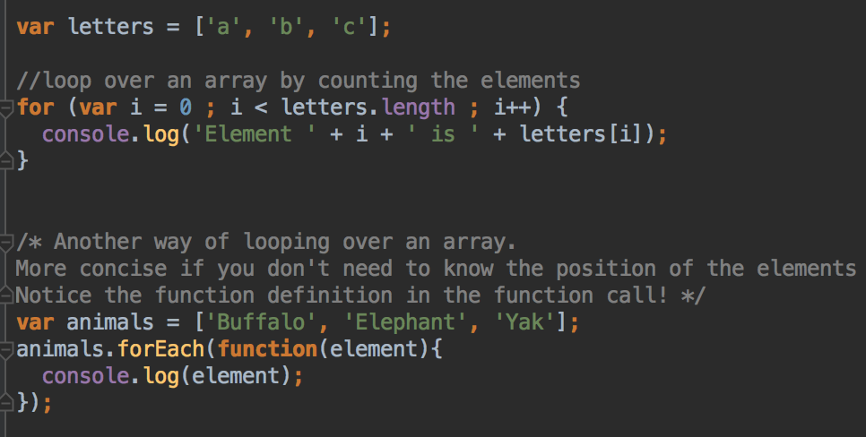
Looping over Arrays

Slide 49
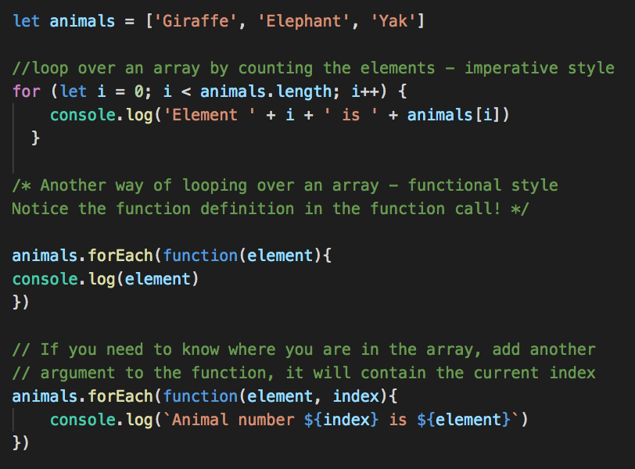
Looping over an array
Imperative and functional approach
Which do you prefer?

Slide 50
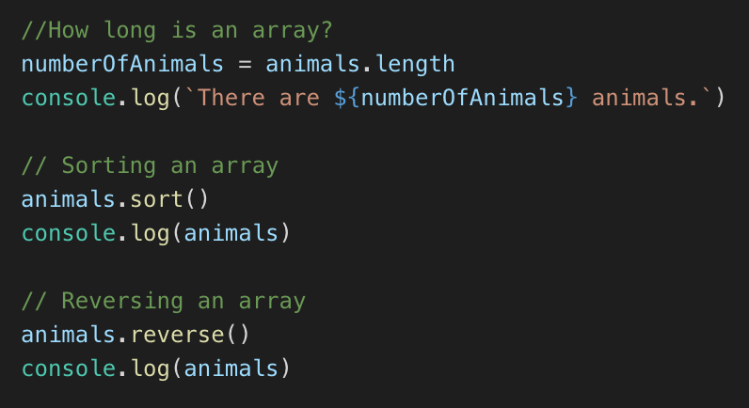
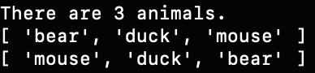
More array operations – length, sort(), reverse()

Slide 51
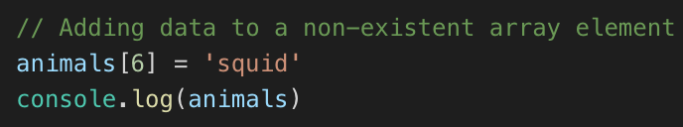
Adding data to an array
What if you try to add data to element 6 of the animals array?
The array only has 3 elements
JavaScript will enlarge the array, put the new element in index 6, and the empty items will be undefined

Slide 52

Reading data from an array
Similarly, if you read data from an element that doesn’t exist, you get undefined
Be aware that your program won’t crash, unlike Python/Java/C#
Common cause of bugs

Slide 53

Arrays in the browser
Student list form, last week's lab
In a form, there could be many input errors
Use array to make a list of all the problems
push adds to the array
join joins all the errors strings for display
Check length property

Slide 54

Your Turn Tree order form
Start with this page
https://git.io/fjhtC
Complete the validation JavaScript
And display an order summary if the form is completed

Slide 55
Form validation
Why not rely on HTML form validation?
Not all browsers handle validation attributes in the same way
For example, Safari doesn't enforce required elements
HTML form validation is helpful...
But JavaScript form validation is more reliable in the client, and more user friendly
When we get to servers, we'll talk about why JavaScript validation is ONLY to be user friendly, and why you should validate AGAIN on the server before you save data. It's very very easy to bypass client-side checks on data

Slide 56

JavaScript Objects
JavaScript is very relaxed about objects
Can create an object on the fly, no class definition needed
Use { } to define an object
List properties, which are name:value pairs
Separate names and values with :

Slide 57
Your Turn
Create a new file first_objects.js
Create an object containing your name and a fake password
Run your program from the command line / terminal with
node first_objects.js
Should print your name

Slide 58
Objects and JSON
Define object variables and data with JSON syntax
Pronounced "jason"
JavaScript Object Notation
Dictionary-like structure
{ name : value , name2 : value2 }
Values can be anything – strings, numbers, arrays, other objects – so can have nested structure

Slide 59

Accessing and modifying data in an object
Access by property name
Two ways – dot notation and square bracket notation
Can you print your (pretend) password?

Slide 60


Modifying properties
Again, two ways – dot notation and bracket notation
Can you change your password and print the new value?

Slide 61

Modifying Objects
Can add attributes to objects
Just say myOb.myNewAttribute = newVal
Can you add an email and print it out?

Slide 62

Nested Objects
Values can be other objects, or arrays
Arrays can be composed of objects
These objects and arrays can contain nested objects and arrays

Slide 63
Nested Objects
Create a user object for your information in your dream job:
name
email
password
contact (an object with office and telephone)
roles (an array)
In code, add a property for your salary, as a number
In code, add "server admin" to your roles
Add the office location, e.g. (location: "Minneapolis") to the contact object

Slide 64

JSON
Is used in many contexts outside JavaScript
Many websites (and other systems) "speak" JSON to other systems; as part of their API
For example, an Android or iOS may request information from a website, and receive JSON data in return; the JSON will then be processed in Java/Kotlin or Swift
https://samples.openweathermap.org/data/2.5/group?id=524901,703448,2643743&units=metric&appid=439d4b804bc8187953eb36d2a8c26a02, part of response

Slide 65

Your Turn: Nested objects and arrays in JSON
Start with this code: https://git.io/JU3l6
Can you print the current wind speed?
Can you print all of the weather descriptions?
Can you print the current humidity?

Slide 66


Looping and objects
Loop over all the property names of an object using a for …. in loop
As you loop over property names, you can access each property's value using square bracket syntax

Slide 67
Lab - More JavaScript Practice
Please ask if you need any help!

